Slide 1
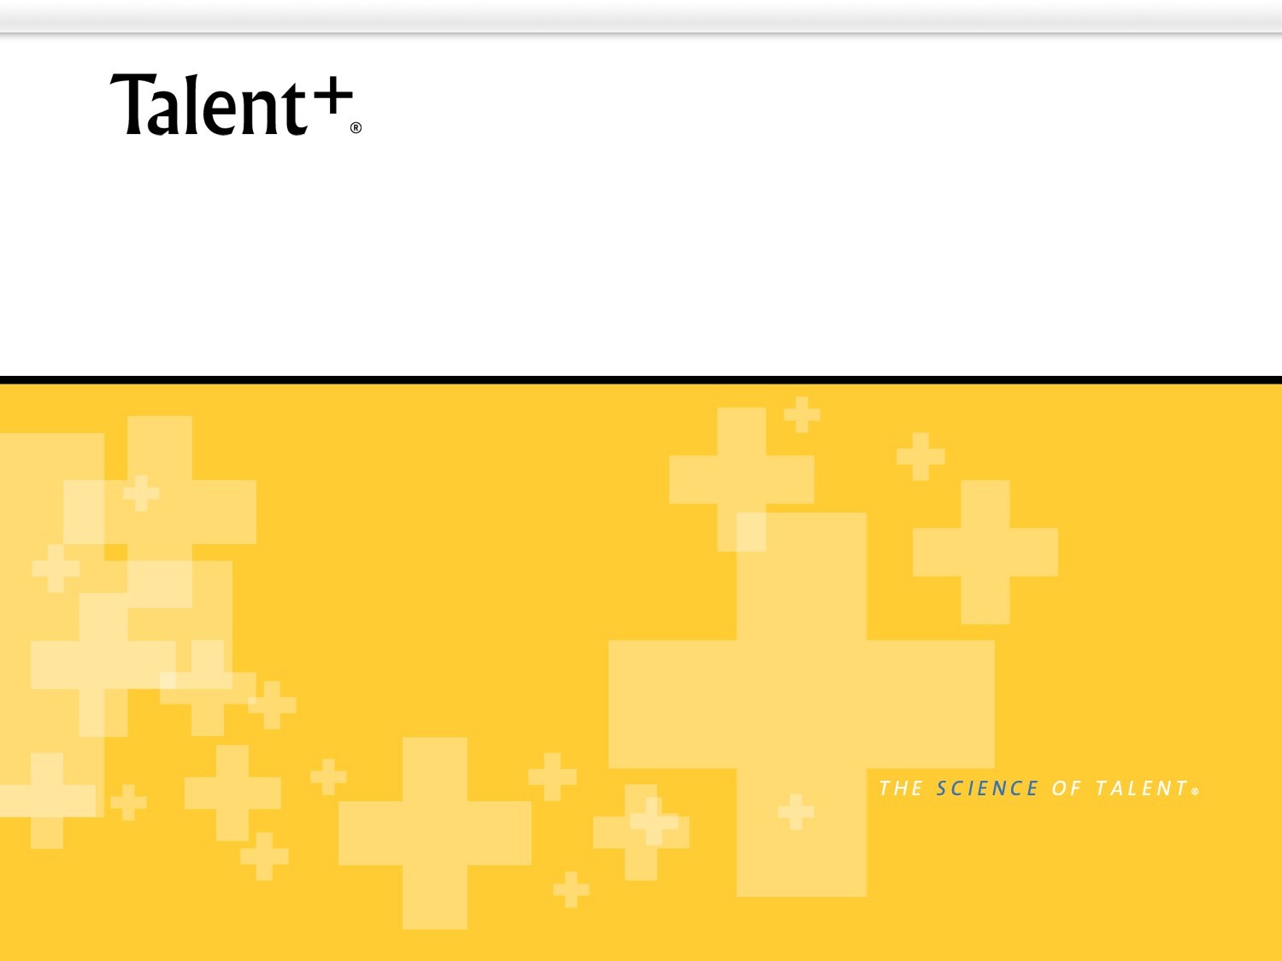
Today’s Talent, Tomorrow’s Leaders
Susan Hirt, PhD
April 15, 2010

Slide 2
Private and Confidential
All materials constituting this presentation (the “Materials”) are confidential and proprietary property solely owned and copyrighted by Talent Plus ®, Inc. (“Talent Plus”). The Materials are intended for use only by the individual or entity that receives the Materials directly from Talent Plus (the “Recipient”) and such individuals associated with the Recipient on a “need to know” basis. The Materials shall not be copied, modified or otherwise reproduced by Recipient without the express written permission of Talent Plus.

Slide 3
Challenge the Myths of Selecting Leaders
If it isn’t broken, don’t fix it.
But…
Good (enough) is the enemy of GREAT.
-Modified from Jim Collins

Slide 4
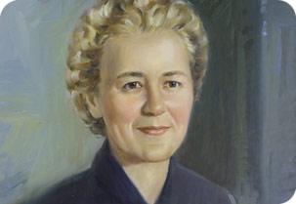
Cancer Treatment Centers of America
The Mother Standard of Care

Slide 5
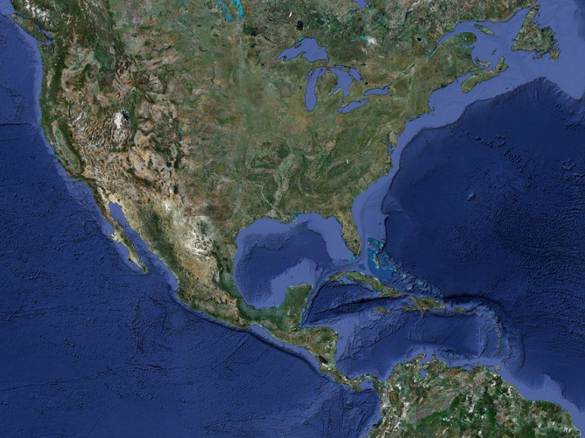
Cancer Treatment Centers of America
Growth Challenge for the future:
Current
locations:
How to
double or
triple in size?
Zion, Illinois
(near Chicago)
Phoenix
Arizona
Philadelphia
Pennsylvania
Tulsa
Oklahoma

Slide 6

Lessons Learned
Jim Collins, Good to Great, 2001:
Studied 1,435 companies
11 achieved greatness
10 of 11 good-to-great CEOs came from inside the company
“Larger-than-life, celebrity leaders who ride in from the outside are negatively correlated with going from good to great.” Page 40

Slide 7
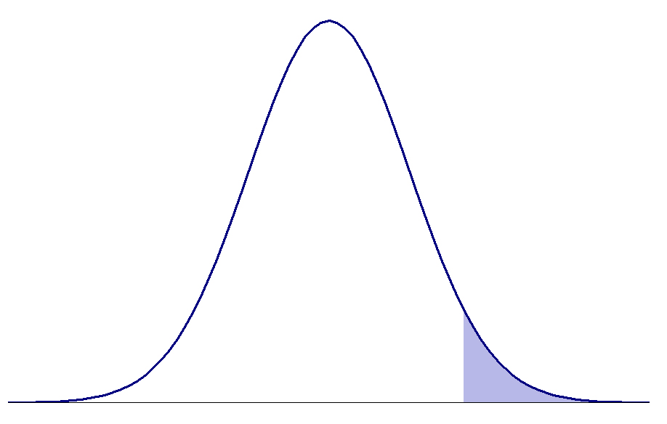
Traditional Criteria for Selection
Education
Experience
Training
Tenure
What is missing?
Top Performers

Slide 8
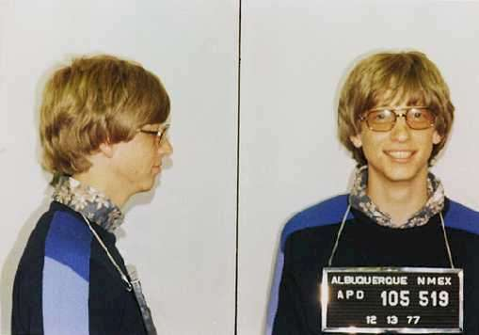
Would you select this person?
Would you select this person today to
become your CEO in 10 years?

Slide 9
What about now?
Select Curriculum Vitae:
Caught stealing in 8th grade
Dropped out of university after only two years
Arrested for running a red light and driving without a license
…because he was a masterful computer “hacker”
…it was Harvard, and he wanted to found a company
…sometimes even smart people make mistakes…

Slide 10
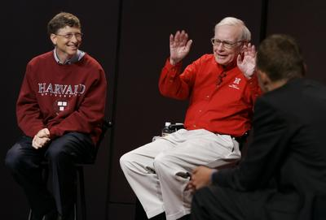
Recognize him now? On the left…

Slide 11
Can Be Acquired or Cannot Be Acquired?
An M.B.A.
A Ph.D.
Caring
Work Ethic
Responsibility
10 Years of Experience
Industry understanding
A Developer
Drive to Achieve
Positivity
Professional network
Integrity
Computer skills
Focus
Problem-solving ability
Persuasion
Empathy
Vision
What is a natural ability vs. something acquired?

Slide 12
Excellence
Speed readers – words per minute
90
135
50 percent improvement
225
2000
790 percent improvement
More talent = Greater potential

Slide 13
Definition of Talent
A natural ability not acquired through effort.
Training refines talent but does not create it.
Hire people as they are; if you get a change,
it’s a bonus.

Slide 14
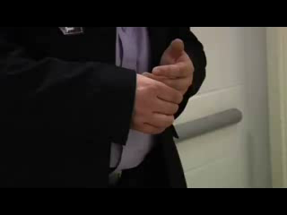
Selecting with the right criteria

Slide 15
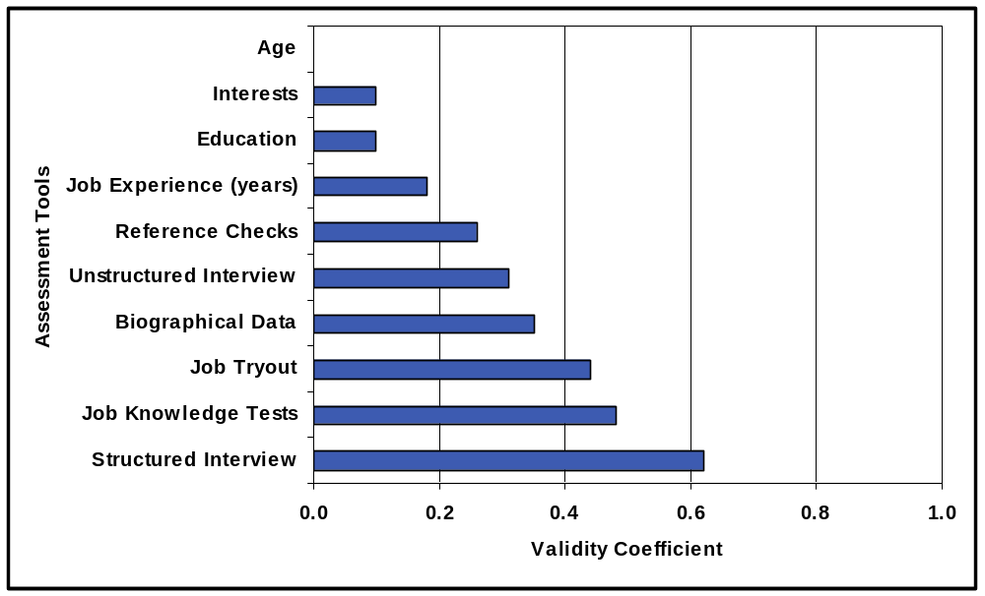
Predictive Validity of Various Assessments
(-.01)
Sources:
Hunter, J.E., & Hunter, R.F. (1984). Validity and utility of alternate predictors of job performance. Psychological Bulletin, 96, 72-98.
McDaniel, M.A., Whetzel, D.L., Schmidt, F.L., & Maurer, S.D. (1994). The validity of employment interviews: A comprehensive review and meta-analysis. Journal of Applied Psychology, 79, 599-616.
Wiesner, W.H., & Cronshaw, S.F. (1988). A meta-analysis investigation of the impact of interview format and degree of structure on the validity of the employment interview. Journal of Occupational Psychology, 61, 275-290.

Slide 16
Structured vs. Traditional Interviewing
Traditional interview gives you…
Structured interview gives you…
STUDY AND UNDERSTAND YOUR BEST PERFORMERS, NOT YOUR AVERAGE!

Slide 17

What you see
First Impression
Interview Skills
Education
Clothing
Work Experience
What you don’t see
Curiosity
Persuasive Ability
Ambition
Positive Attitude
Honesty
Goal Orientation
Caring
Work Ethic
Team Work
Wednesday, August 09, 2006
Talent Plus &Quality Selection Process (QSP)

Slide 18
Structured Interview Methodology
Founded in the work of Carl Rogers
Understand spontaneous behaviors
Sample questions:
  Measure individual talent
  Measure leadership talent

Slide 19
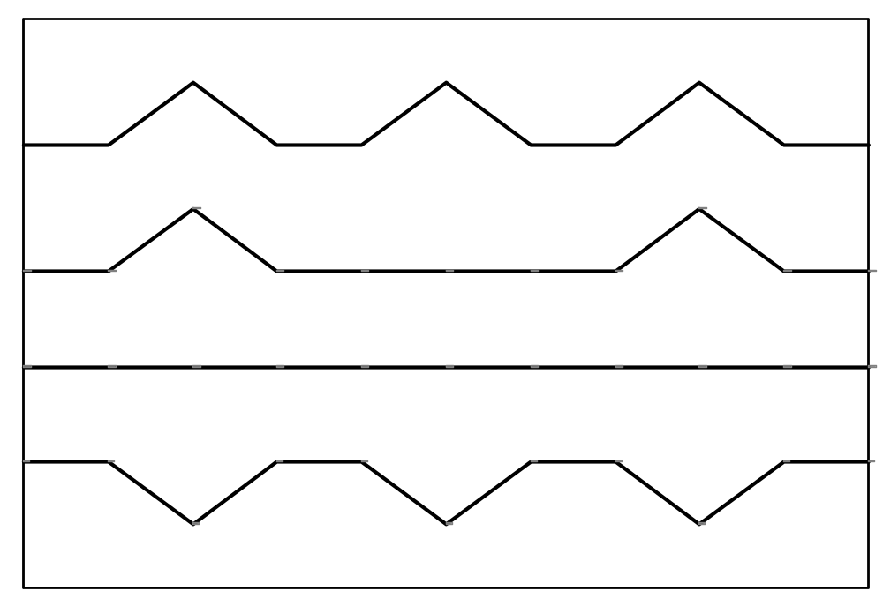
Theme Predictability
Stimulus
Stimulus
Stimulus
Always
Consistent Reaction
Situational Reaction
Sometimes
No Reaction
I Don’t Know
Negative Reaction
Never
Questions = Stimulus

Slide 20
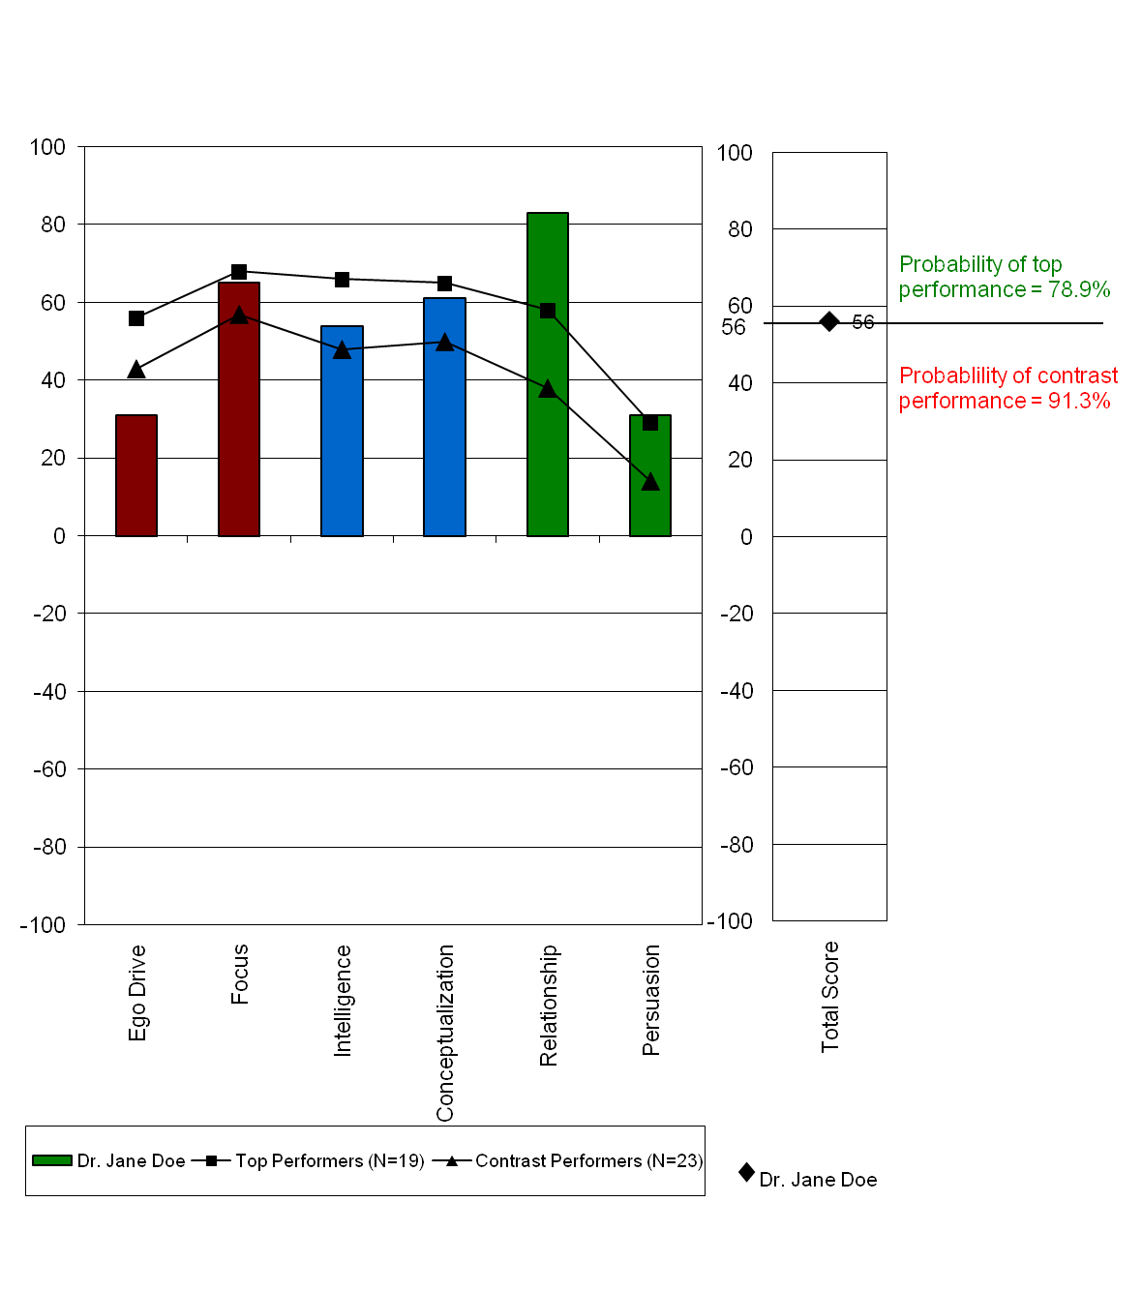
Compare Candidates with the Best

Slide 21
CTCA Leadership Solution:
Create a program that:
Brings young professionals into the company
Measures their future leadership potential
Provides them with an intensive business orientation
Offers them a long-term career path
Ensures the company will have leaders for future growth
Management Fellows Program

Slide 22
Management Fellows Program
Build relationships with various colleges
Recruit in the fall for students graduating in the spring
  Filter: Review candidates’ resumes
  Filter: Interview candidates on campus
  Filter: Measure leadership potential through structured interview
  Filter: Invite final candidates to visit CTCA headquarters
Select approximately 5 new fellows each year
2-year Rotation through different positions
Permanent position offered after 2-year fellowship ends

Slide 23
Recruitment of Management Fellows
Campus Recruitment
Resume Review
In-person Interview is structured
Theme-based Screening Questions

Slide 24
Selection of Management Fellows
Structured Interview for Leadership
Standardized Questions
Measures 9 Leadership Characteristics
Additional Interview for Individual Contribution
Examples of Leadership Questions

Slide 25
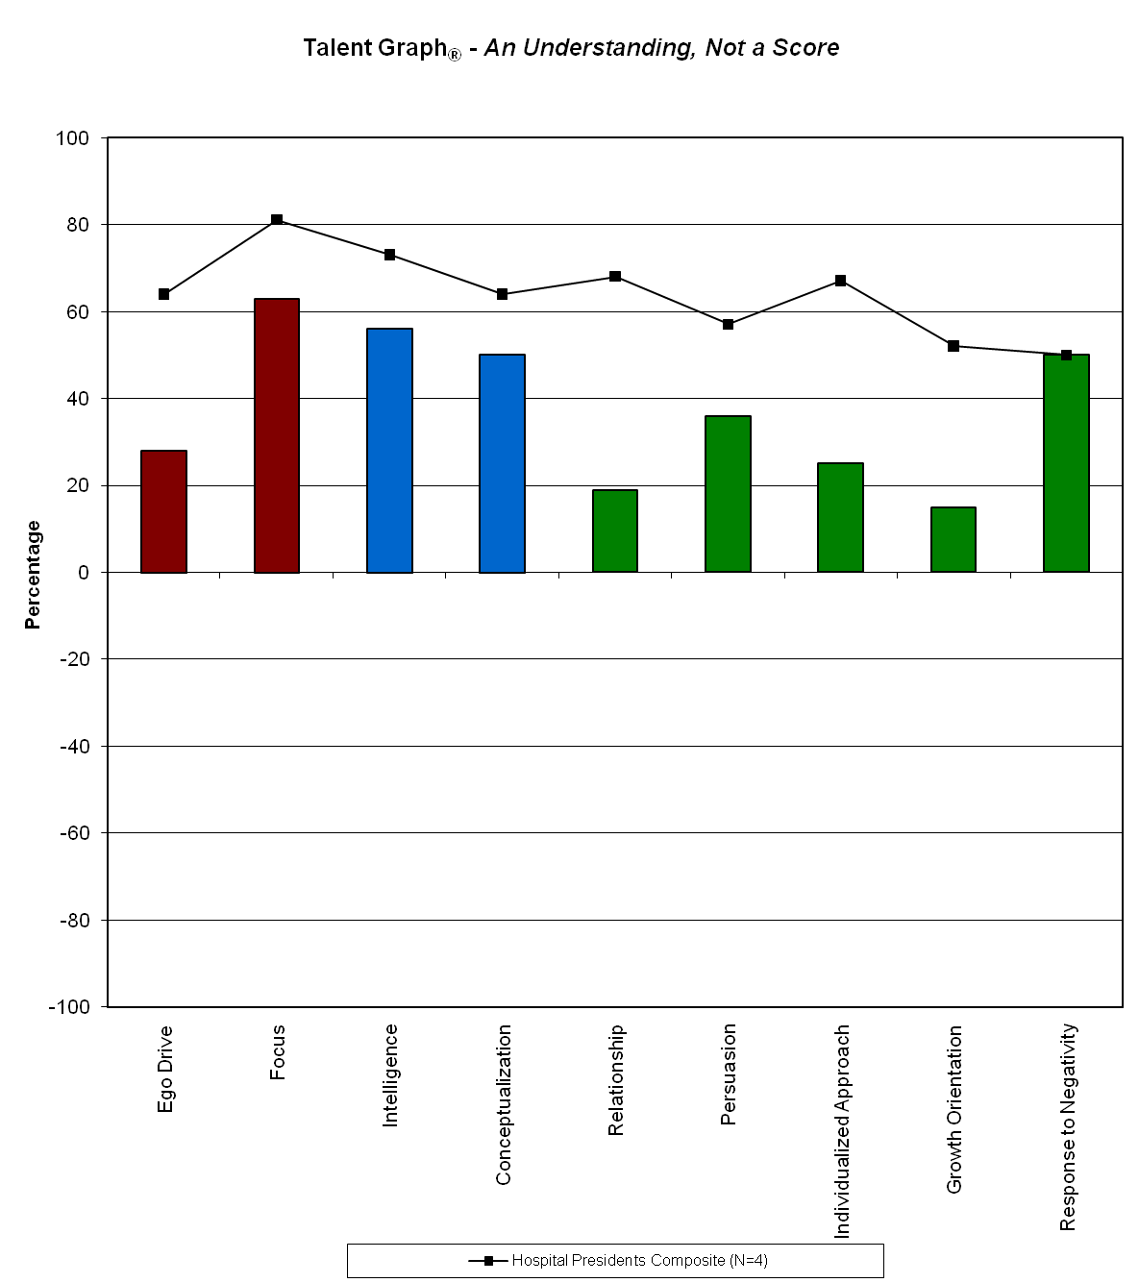
Compared to Current Leaders

Slide 26
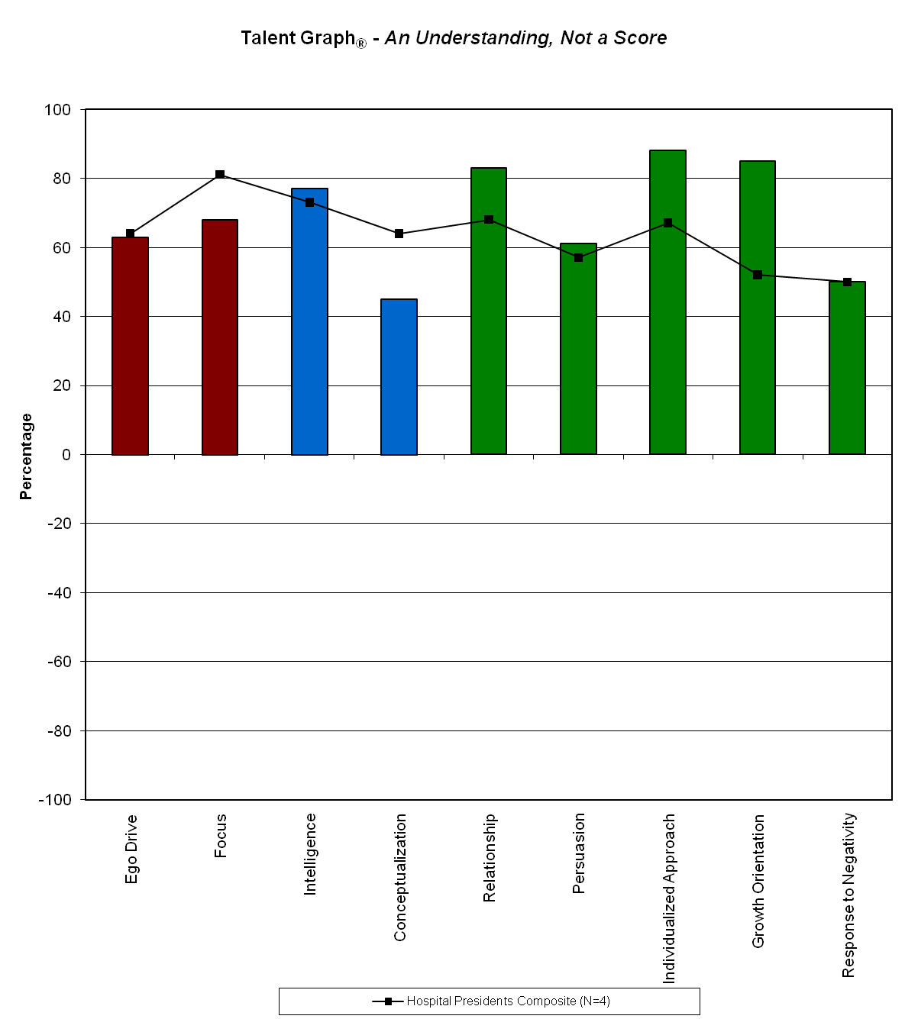
Compared to Current Leaders

Slide 27
Management Fellows 2-Year Program
Orientation
Feedback on Leadership Talent Profile
Networking with Current Executives
Participation in Board Meetings
3-Month Rotation

Slide 28
Fellows’ Success Stories
Hospital Director of Marketing
Corporate Vice President of Talent
Co-Founder of Investment Venture
Hospital CEO

Slide 29
Ideas to Consider
Evaluate your selection criteria – Do they correlate to best performance?
Make natural talent the top selection priority
Alternative to traditional interview methods
Succession Planning – Make it a discipline
Enrich your internal leadership pool

Slide 30
How Do You Select?
The “right person” has more to do with character traits and innate abilities than specific knowledge, background or skills.
+ Jim Collins
“Good to Great”
“The organization will never be what the people are not.”
+ Price Pritchett
“The Ethics of Excellence”

Slide 31
Companies Are Known By The People They Keep. ®

